Slide 1



January 2026
Treasurer’s Report
Sunni Samuels-Larry Treasurer
Richelle Mills
Assistant Treasurer

Slide 2
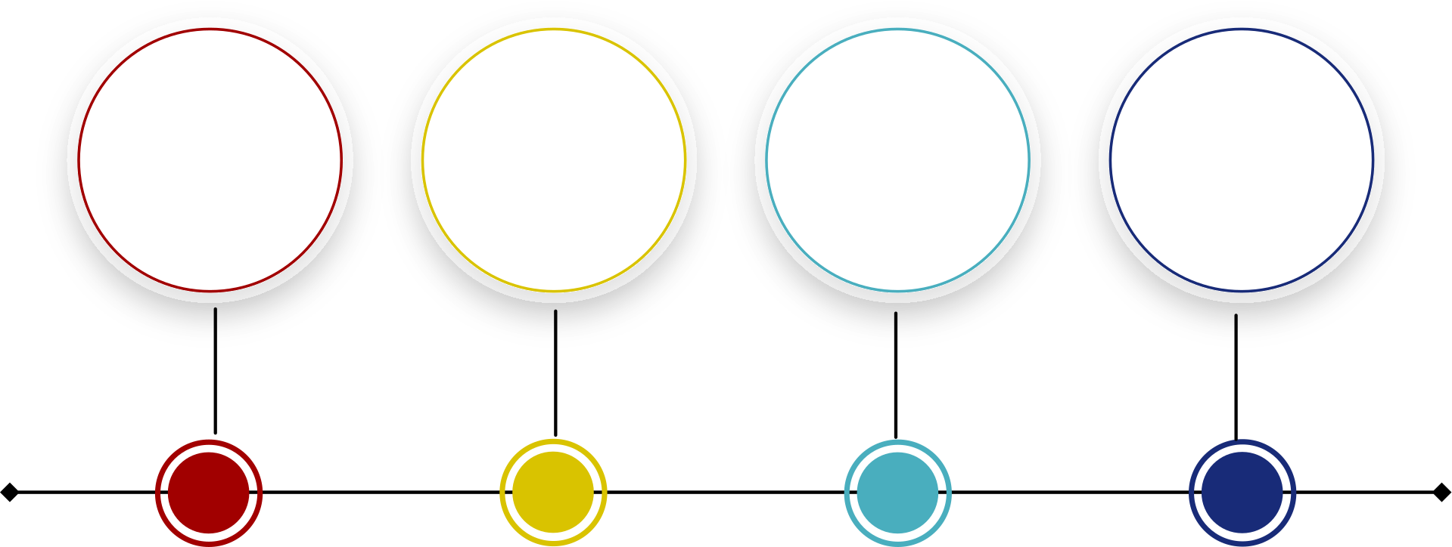
2025 Reports
December 2025 Reports
  Reconciliation Report
  Income & Expenses
  Deposit Detail
  Miscellaneous

Slide 3
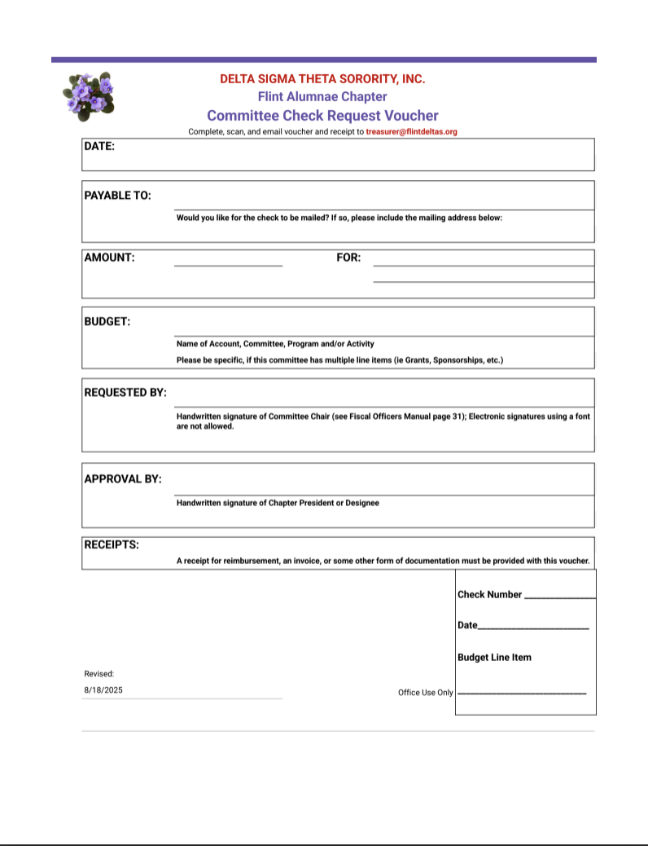
Comments & Updates
1
NEW Check Request Voucher Form
Chairs, 2026 Committee Income & Expense Document links will be emailed out to you the week of January 18th
2
02
3
2026 FAC Budget Tracker Link
05

Slide 4

We are here at treasurer@flintdeltas.org!!

