Slide 1
Delta Sigma Theta Sorority, Inc.
Flint Alumnae Chapter
Internal Audit Committee Report
4th Quarter 2025
Review Date: 1/29/2026
Q4 Audit Performed By:
Brianna Rimmer, Committee Chair
Sorors Shannon Cannon, Penny Herd, Kimberly Reese

Slide 2
Internal Audit Committee Review
Fourth Quarter Audit Period
  October 1– December 31, 2025
  Internal Audit Review Date: January 29, 2026
Internal Audit accounts reviewed
  Huntington Bank (Checking)
  Chase (Checking)
  Chase (Savings)

Slide 3
Internal Audit Committee Review
Internal Audit areas reviewed
  Receipts
  Expenditures
  Members’ dues verification (No Exceptions)
  Bank balances
  Bank reconciliation
  Adherence to budget line items validated
  Monthly chapter reports completed and presented to the chapter during chapter meeting

Slide 4
Internal Audit Committee Review
Receipts validated
  Statistical sample of 50% of total deposits during Q4 was the sample size of 3.
Notes:
-

Slide 5
Internal Audit Committee Review
Expenditures validated
  Statistical sample of 25% of total checks written during Q4.
  18 was the sample size

Slide 6
Internal Audit Committee Recommendations
I/A has a recommendation that reports are added to the correct month (there was difficulty finding committee reports).

Slide 7
Internal Audit Committee Review
Overall 4th Quarter Audit Findings
  After review by the Chapter’s Internal Audit Committee, it has been determined that the chapter has satisfactory financial internal controls, and the review supports the existence and utilization of these controls.

Slide 8
Delta Sigma Theta Sorority, Inc.
Flint Alumnae Chapter
Internal Audit Committee Report
Annual Audit
Report Date: 02/26/2026
External Audit Completed by John L Financial Services & AIAR Submitted By:
Brianna Rimmer, Committee Chair

Slide 9
External Audit Review
Conducted by
  Antonio Brown, CPA The John L Group
QuickBooks
Fiscal Officers Manual
2025 – 2026 Policies & Procedures
2025 Treasurer Reports

Slide 10
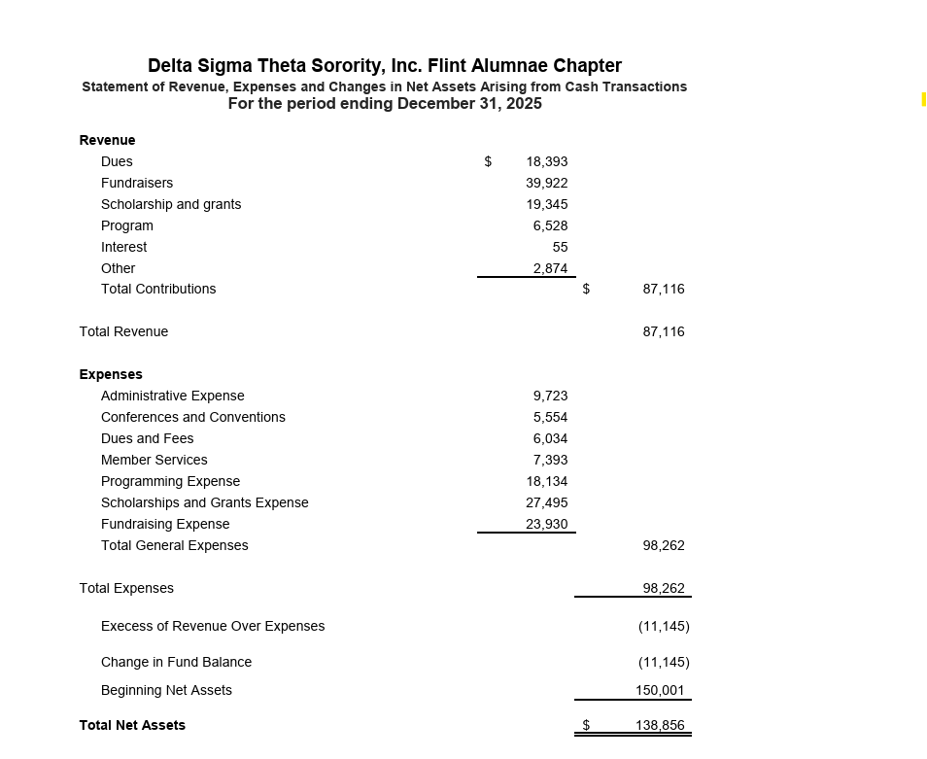
External Audit Review
Outputs

Slide 11
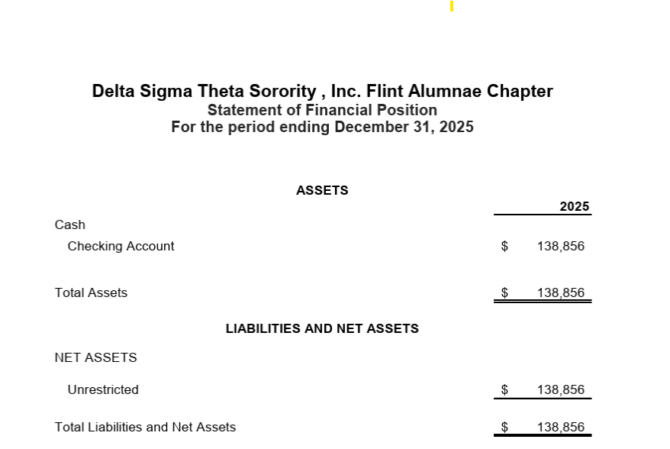
External Audit Review
Outputs

Slide 12
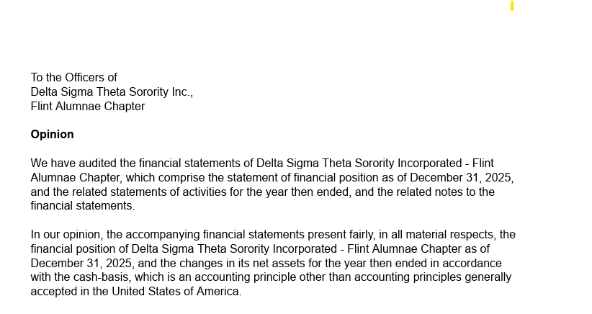
External Audit Review
Findings

Slide 13
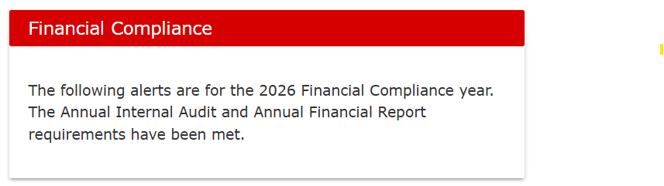
Financial Compliance with Grand Chapter
Reports were due February 28, 2026, we submitted February 27, 2026

Slide 14
Delta Sigma Theta Sorority, Inc.
Flint Alumnae Chapter
Internal Audit Chair:
Brianna Rimmer
InternalAudit@flintdeltas.org

