Slide 1



March 2026
Treasurer’s Report
Sunni Samuels-Larry Treasurer
Richelle Mills
Assistant Treasurer

Slide 2
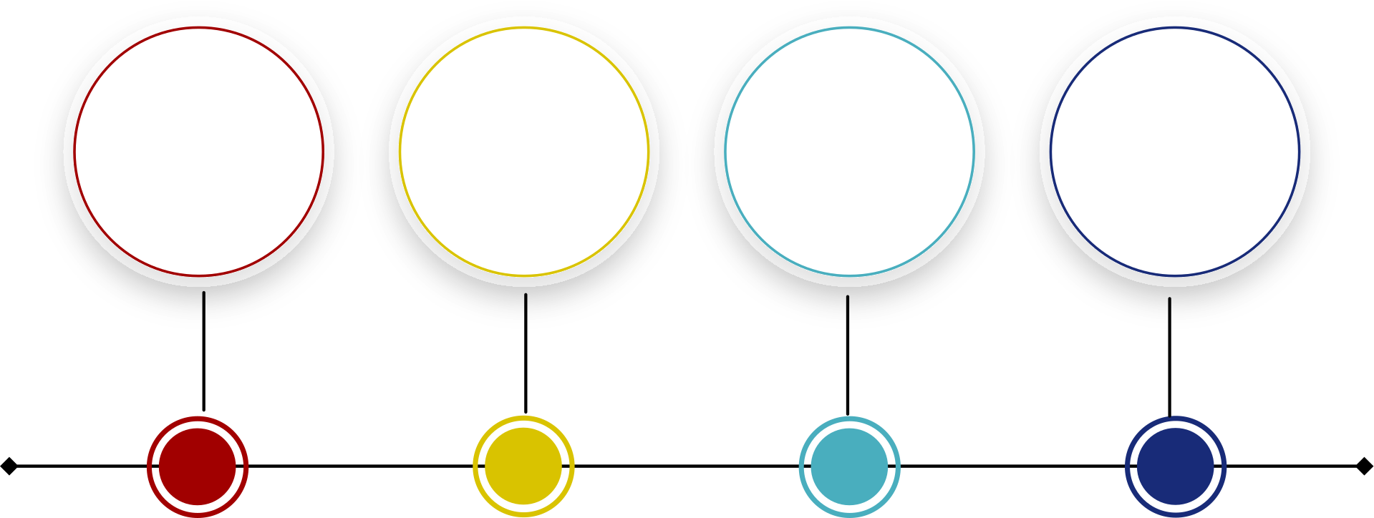
2026 Reports
February 2026 Reports
  Reconciliation Report
  Income & Expenses
  Deposit Detail
  Miscellaneous

Slide 3
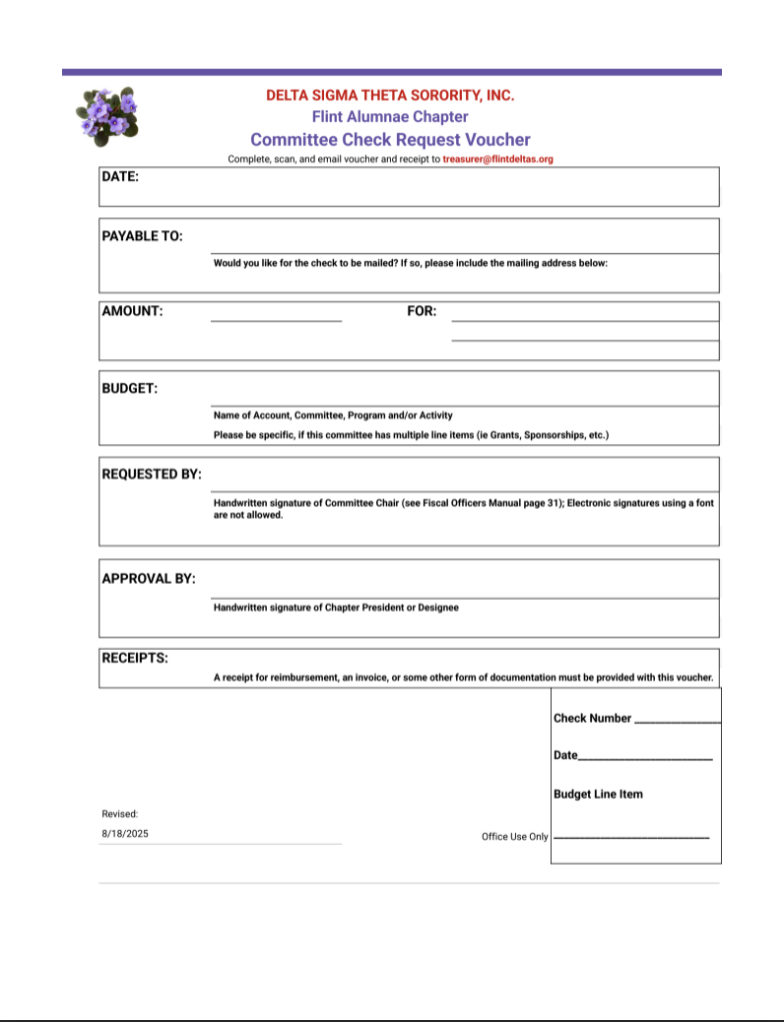
Comments & Updates
1
NEW Check Request Voucher Form
Chairs, 2026 Committee Income & Expense Document links were emailed out to you. Always review the report for details of income and expenses for your committee.
2
02
3
2026 FAC Budget Tracker Link
05

Slide 4

We are here at treasurer@flintdeltas.org!!

