Slide 1
FAC 2026 Financial News
Brought to you by your local friendly FAC Financial and Assistant Financial Secretaries!
Sorors Tamara Dunn and Monica Gillum

Slide 2
2026 Dues Collection Season
Amount collected is $375 for Regular Member plus $15 reinstatement fee
Amount collected is $185 for Golden and Diamond Life Members.
A $30 fee is assessed for Regular Members Only if not financial for more than 2 years.

Slide 3
2027 Dues Collection Season
Amount collected is $375 for Regular Member
Amount collected is $185 for Golden and Diamond Life Members.
In person collections
Sept 19th Chapter meeting
Can also mail in after July 1st to PO Box
Pay using link pinned in group me chat
Deadline Sept 30th before late fees!

Slide 4
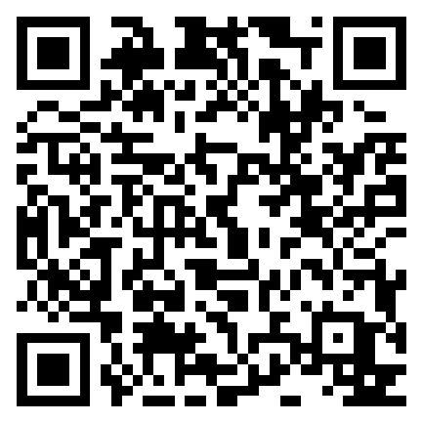
Payment Links
Chaplain Council donation
Chaplain's Council Donations

Slide 5
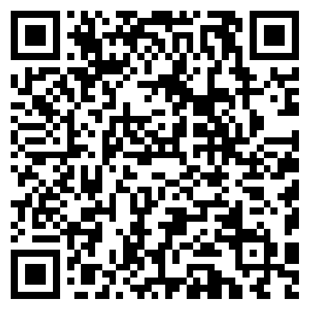
Payment Links
Dues 2026 Fiscal Year
https://form.jotform.com/Techies_FAC/2026FACDues

Slide 6
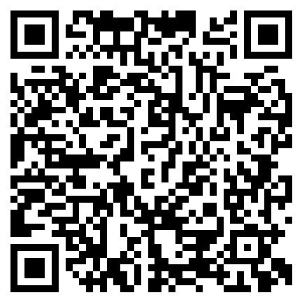
Payment Links
Dues 2027 Fiscal Year
https://form.jotform.com/Techies_FAC/2027-fac-dues

Slide 7
Contact Information
Tamara Dunn
810-275-3379
financialsecretary@flintdeltas.org
Monica Gillum
810-964-2359
FACcrimsontide21@gmail.com

Slide 8
June- August Financials at a Glance

