Slide 1



September 2026
Treasurer’s Report
Richelle Mills
Treasurer
Sa’Cre Hill
Assistant Treasurer

Slide 2
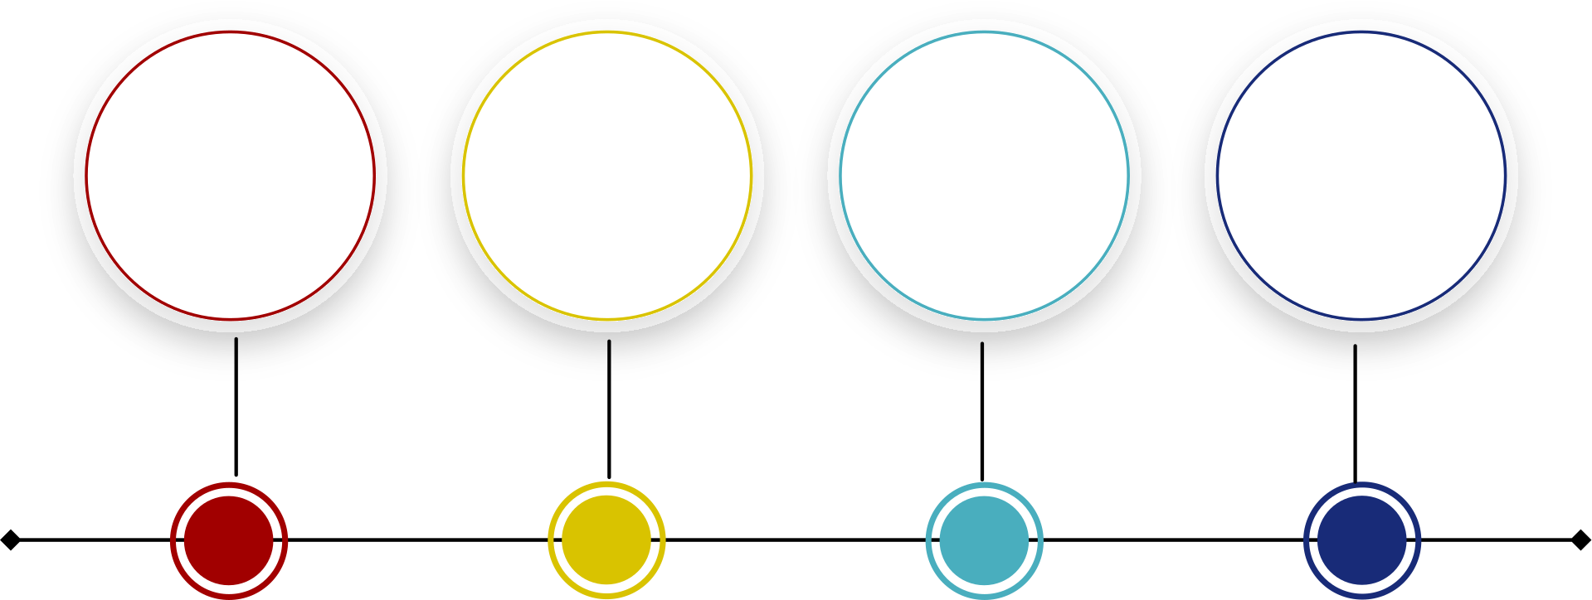
2026 Reports
June 2026 Reports
July 2026 Reports
August 2026 Reports
  Reconciliation Report
  Income & Expenses
  Deposit Detail
  Miscellaneous
  Reconciliation Report
  Income & Expenses
  Deposit Detail
  Miscellaneous
  Reconciliation Report
  Income & Expenses
  Deposit Detail
  Miscellaneous

Slide 3
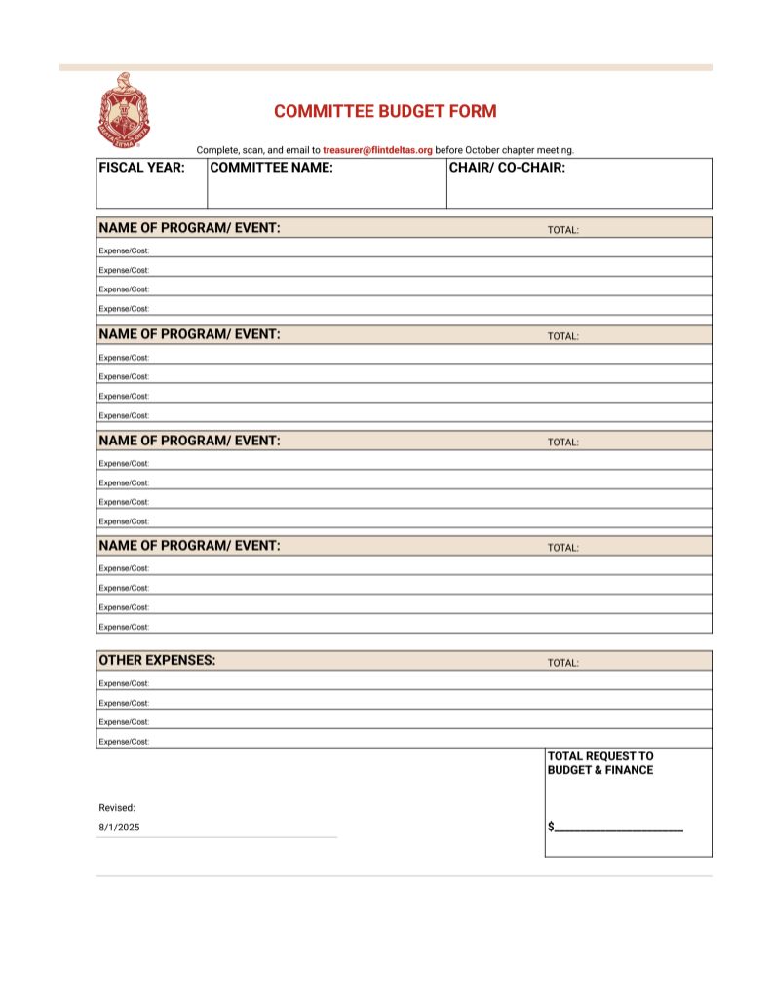
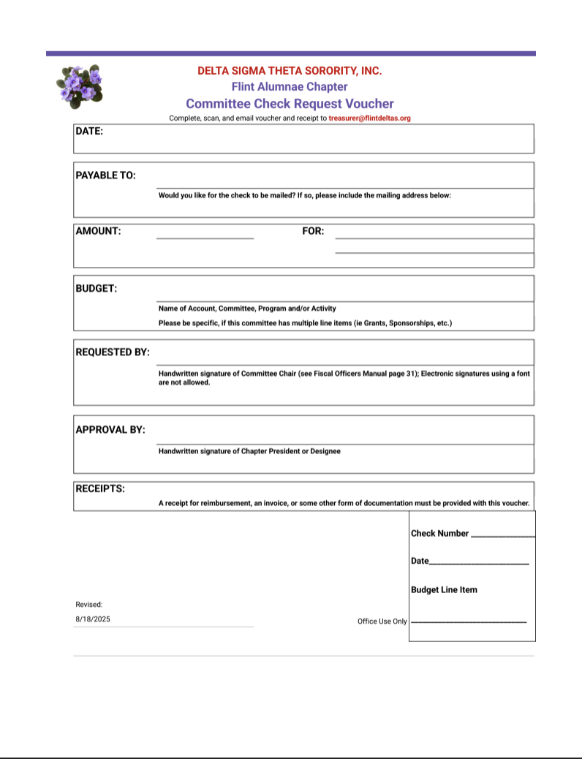
Comments & Updates
1
Check Request Voucher Form
Chairs, please use the Committee Income & Expense Document that has been emailed to you for keeping track of 2025 budgets
2
02
2026 COMMITTEE BUDGETS ARE DUE before the October Chapter Meeting; Please complete and send the Budget Submission Form to treasurer@flintdeltas.org
3
4
2026 FAC Budget Tracker Link
05

Slide 4
We are here at treasurer@flintdeltas.org!!
Richelle Mills - Treasurer
and
Sa’Cre Hill - Assistant Treasurer
Flint Alumnae Chapter
Delta Sigma Theta Sorority, Inc.
flintdeltas.org
P.O. Box 13198
Flint, MI 48501

